Slide 1
NextGenATS: Revolutionizing the Hiring Process
AI-Powered Applicant Tracking System
Team Members: Vishaka Pahuja & Mohammad Yaqoob
Supervisor: Sir Rizwan Abro
Sukkur IBA University

Slide 2
Introduction
Overview of the project
Purpose
NextGenATS is an AI-powered tool that makes hiring easier and faster. It helps companies by automatically reviewing resumes, scoring candidates, and scheduling interviews
The project aims to create an
AI-driven tool that helps HR teams
by automating tasks,
improving candidate experience,
and allowing companies to handle
large volumes of applications efficiently.

Slide 3
The Problem
01
02
03
04
05
06
Hiring is time-consuming and labor-intensive.
Large volumes of applications make it difficult to manually screen every resume.
Bias in the initial stages of hiring can lead to less diversity and poor hiring decisions.
Job seekers may face delays
and lack of feedback,
leading to a poor
impression of the
company.
The manual and lengthy hiring process can be expensive, with costs associated with time, resources, and potential job vacancies.
Companies need an efficient and unbiased system to identify the best candidates quickly.

Slide 4
The Solution - NextGenATS
AI-driven resume parsing and scoring.
Automated assessment generation based on job requirements.
Streamlined interview scheduling for top candidates.
Provides immediate feedback to applicants, reducing waiting time.
Reduces bias by focusing on data-driven evaluations.

Slide 5
Technologies Used
Frontend
Backend
Database
HTML, CSS, JavaScript
Django
Firebase/MongoDB
AI/ML
NLP/Machine Learning Model for Resume Parsing. And Generating Assessments
Cloud Services
Email Notifications
Deployment on Azure
Automate email notifications for interview

Slide 6
Thanks!
Do you have any questions?

Slide 7
Whoa!
This can be the part of the presentation where you introduce yourself, write your email…

Slide 8
01
Name of
the section
You can enter a subtitle here if you need it

Slide 9
Do you need longer text?
Mercury is the closest planet to the Sun and the smallest one in the entire Solar System. Contrary to popular belief, this planet's name has nothing to do with the liquid metal. Mercury was, instead, named after the famous Roman messenger god Mercurius
Mercury takes a little more than 58 days to complete its rotation, so try to imagine how long days must be there! Since the temperatures are so extreme, albeit not as extreme as on Venus, Mercury has been deemed to be non-habitable for humans

Slide 10
The slide title goes here!
Do you know what helps you make your point crystal clear? Lists like this one:
They’re simple
You can organize your ideas clearly
You’ll never forget to buy milk!
And the most important thing: the audience won’t miss the point of your presentation

Slide 11
You can divide the content
Mercury
Venus
Mercury is the closest planet to the Sun and the smallest one in the Solar System—it’s only a bit larger than the Moon
Venus has a beautiful name and is the second planet from the Sun. It’s hot and has a poisonous atmosphere

Slide 12
Here are three important ideas
Mercury
Venus
Mars
Mercury is the closest planet to the Sun and the smallest of them all
Venus has a beautiful name and is the second planet from the Sun
Despite being red, Mars is actually a cold place. It’s full of iron oxide dust

Slide 13
Awesome words

Slide 14
—Someone Famous
“This is a quote, words full of wisdom that someone important said and can make the reader get inspired”

Slide 15
98,300,000
Big numbers catch your audience’s attention

Slide 16
9h 55m 23s
333,000
386,000 km
Jupiter's rotation period
The Sun’s mass compared to Earth’s
Distance between Earth and the Moon

Slide 17
Let’s use some percentages
25%
50%
75%
Mercury
Venus
Mars
Mercury is the closest planet to the Sun and the smallest of them all
Venus has a beautiful name and is the second planet from the Sun
Despite being red, Mars is actually a cold place. It’s full of iron oxide dust

Slide 18
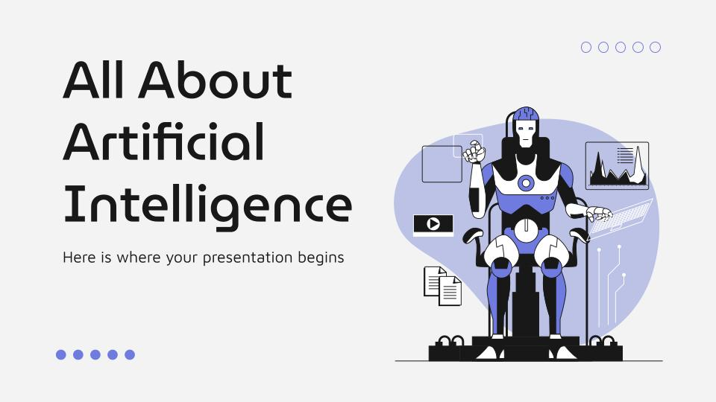
Computer mockup
You can replace the image on the screen with your own work. Just right-click on it and select “Replace image”

Slide 19
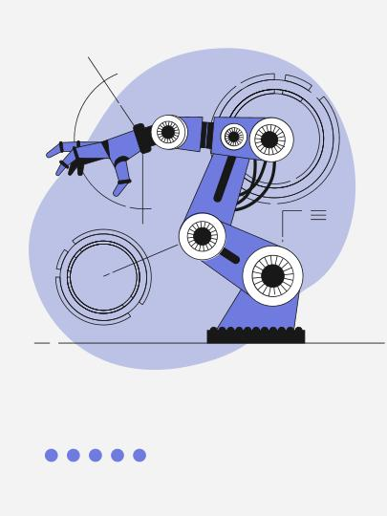
Tablet mockup
You can replace the image on the screen with your own work. Just right-click on it and select “Replace image”

Slide 20
Evolution of artificial intelligence
1950
1997
2016
2020
Venus is a beautiful place
Saturn is the ringed planet
Mars is red and a cold place
Jupiter is the biggest planet

Slide 21
AI breakthrough
Applications
Venus is the second planet from the Sun
Innovation
Challenges
Mercury is the closest planet to the Sun
Saturn is a gas giant and has several rings

Slide 22
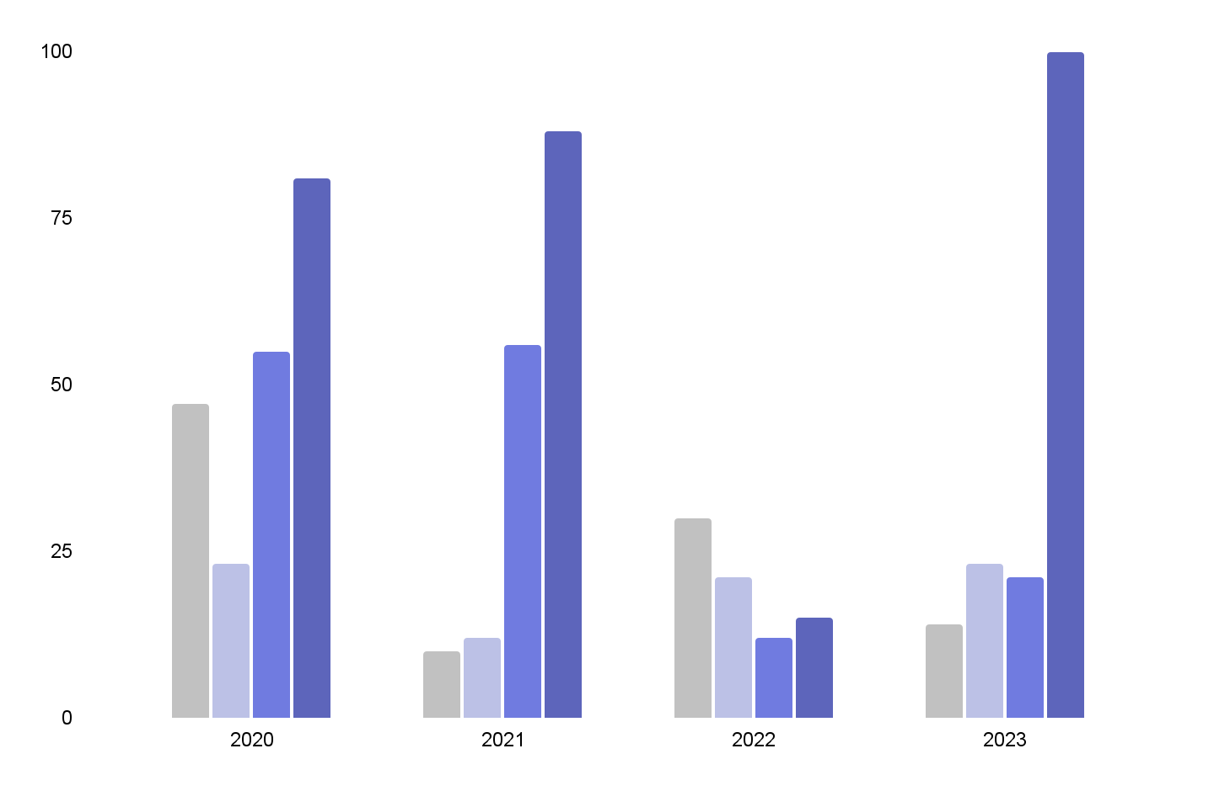
Growth in the use of AI
Manufacturing
Transportation
E-commerce
Agriculture
Mercury is the smallest planet
Venus has very high temperatures
Jupiter is the biggest planet
Saturn is a gas giant with rings
Follow the link in the graph to modify its data and then paste the new one here. For more info, click here

Slide 23
Artificial intelligence applications
Robotics
Surveillance
Mars is actually a very cold place
Venus has extremely high temperatures
NLP
Games
Jupiter is the biggest planet of them all
Saturn is a gas giant and has several rings

Slide 24
Comparison
AI
Human skills
Earth is the third planet from the Sun and the only one that harbors life in the Solar System. All humans live on this planet
Despite being red, Mars is actually a cold place. It’s full of iron oxide dust, which gives the planet its reddish cast

Slide 25
Popular AI models
Mars
Venus
Mars is actually a very cold place
Venus has extremely high temperatures
Mercury
Saturn
Jupiter
Mercury is the closest planet to the Sun
Saturn is a gas giant with several rings
Jupiter is the biggest planet of them all

Slide 26
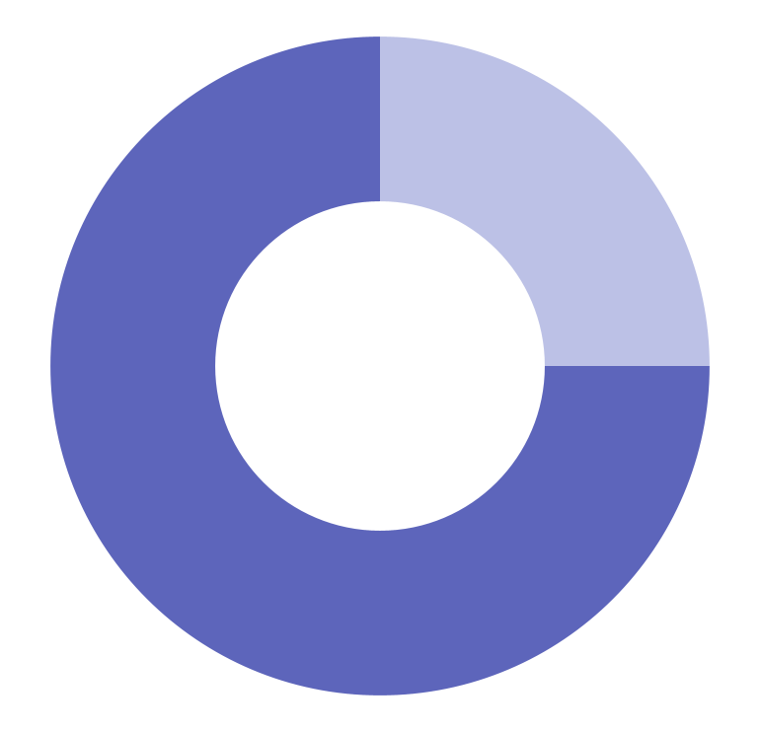
Impact of Artificial Intelligence
25%
Advancements
Despite being red, Mars is a very cold place
75%
Opportunities
It is the biggest planet in the Solar System
Follow the link in the graph to modify its data and then paste the new one here. For more info, click here

Slide 27
Impact of AI
25%
50%
75%
90%
Healthcare
Economy
Education
Technology
Despite being red, Mars is a actually a cold place
Jupiter is the biggest planet in the Solar System
Earth is the only planet with life of all of them
Mercury is the smallest planet of them all

